Slide 1

East India company
CLASSES WITH AWAIS

Slide 2
SAMPLE QUESTION, 7 Marks
Why did the British East India Company establish in Sub-Continent?

Slide 3
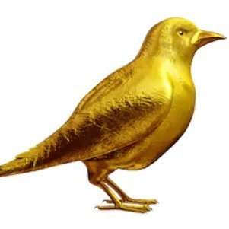
SAMPLE QUESTION, 7 Marks
At that time, the subcontinent was commonly know as “GOLDENSPARROW” because a large amount of Gold, Silver, diamond, jewelry, silk, spices and so on all were flurshing in India. So it was the biggest reason for establishment of this company because British wanted to capture the wealth of India

Slide 4

SAMPLE QUESTION, 7 Marks
First time in the World Industrial Revolution came in Britain and they prepared weapons and machinery. They started their business in Indonesia and South Africa but failed, so they were looking for a new trading market for their goods. India was the best choice because this area was rich so the British Could easily sale their weapons and machinery here.

Slide 5
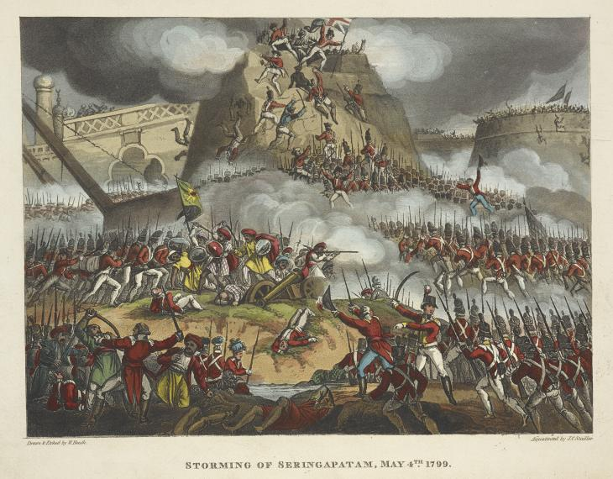
SAMPLE QUESTION, 7 Marks
The British wanted to increase their political influence in the East. They also wanted to drive French, Dutch, Portuguese out of India. They also wanted to capture the warm water sea ports of India due to their strategic importance.

Slide 6
SAMPLE QUESTION, 7 Marks
At that time, the subcontinent was commonly know as “GOLDENSPARROW” because a large amount of Gold, Silver, diamond, jewelry, silk, spices and so on all were flurshing in India. So it was the biggest reason for establishment of this company because British wanted to capture the wealth of India
First time in the World Industrial Revolution came in Britain and they prepared weapons and machinery. They started their business in Indonesia and South Africa but failed, so they were looking for a new trading market for their goods. India was the best choice because this area was rich so the British Could easily sale their weapons and machinery here.
The British wanted to increase their political influence in the East. They also wanted to drive French, Dutch, Portuguese out of India. They also wanted to capture the warm water sea ports of India due to their strategic importance.

Slide 7
SAMPLE QUESTION 2, 7 Marks
Why did the British Parliament take direct control of East India Company in the sub-continent?

Slide 8

SAMPLE QUESTION 2, 7 Marks
Since, East India Company was a private owned company so the whole revenue coming from India was going under the Control of few British Officers. The British Government wanted to get the direct control over the revenue coming from India.

Slide 9

SAMPLE QUESTION 2, 7 Marks
Till 1740, about 10 % British revenue was coming from India. When the British won various battles in India like Battle of Plassey and got control over many areas and their wealth. So much revenue was expected to come from India. The British Govt. could not take risk to loose the Business, so they got the Control of this Company.

Slide 10

SAMPLE QUESTION 2, 7 Marks
In the East, Russia was the next emerging power and it could be the biggest danger for the British. Due to the Russia entry to India, the British might loose the business and wealth. The british would be able to capture Afghanistan and it was a matter of pristige, so they decided to get the direct control of affairs of EAST INDIA COMPANY

Slide 11
SAMPLE QUESTION 2, 7 Marks
Since, East India Company was a private owned company so the whole revenue coming from India was going under the Control of few British Officers. The British Government wanted to get the direct control over the revenue coming from India.
Till 1740, about 10 % British revenue was coming from India. When the British won various battles in India like Battle of Plassey and got control over many areas and their wealth. So much revenue was expected to come from India. The British Govt. could not take risk to loose the Business, so they got the Control of this Company.
In the East, Russia was the next emerging power and it could be the biggest danger for the British. Due to the Russia entry to India, the British might loose the business and wealth. The british would be able to capture Afghanistan and it was a matter of pristige, so they decided to get the direct control of affairs of EAST INDIA COMPANY

Slide 12
SAMPLE QUESTION 3, 14 Marks
Why was the Britain so successful in expanding its control in Sub-continent between 1750 and 1850?
Or
Why were the British able to replace Mughals as a dominant force in the Subcontinent?

Slide 13
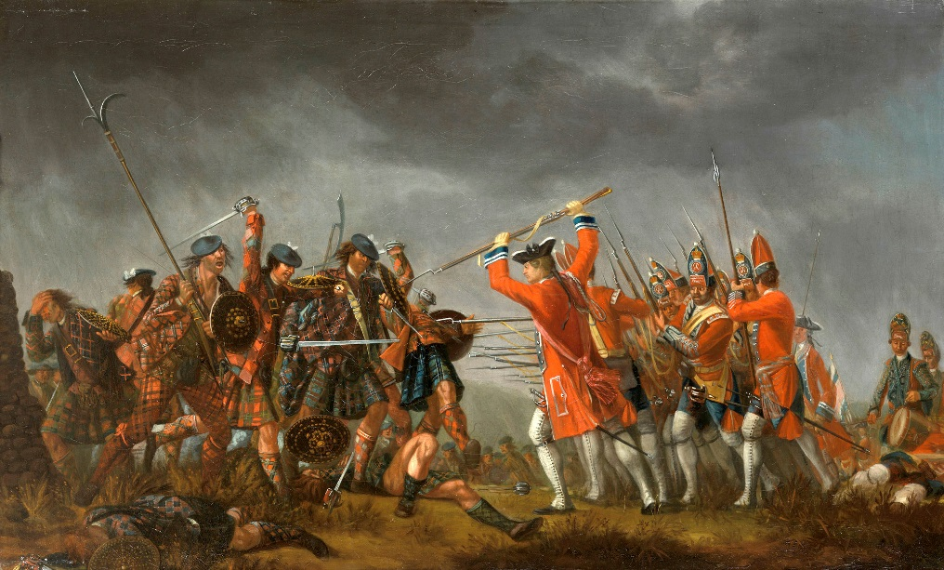
SAMPLE QUESTION 3, 7 Marks
The battles of Plassey and Buxar gave the Bristish the vast riches of Bengal and favorable trading rights with the local NAWABS. The provided massive new resources, which the British could use to consolidate control. When they got the Control of the rich states and their wealth they hured their own soldiers and defeated others

Slide 14
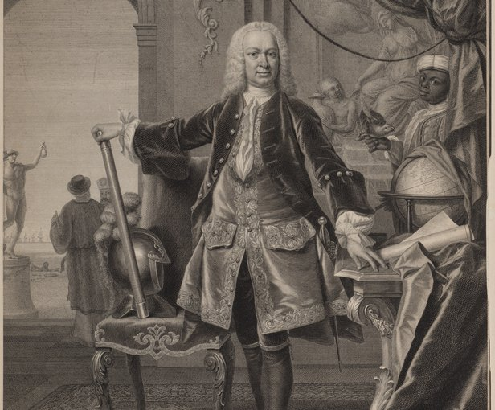
SAMPLE QUESTION 3, 7 Marks
The British also introduced governor-general into the provinces who administered them on British lines and provided yet more control. They also appointed Governors and later Commander in Chief to manage the areas properly

Slide 15
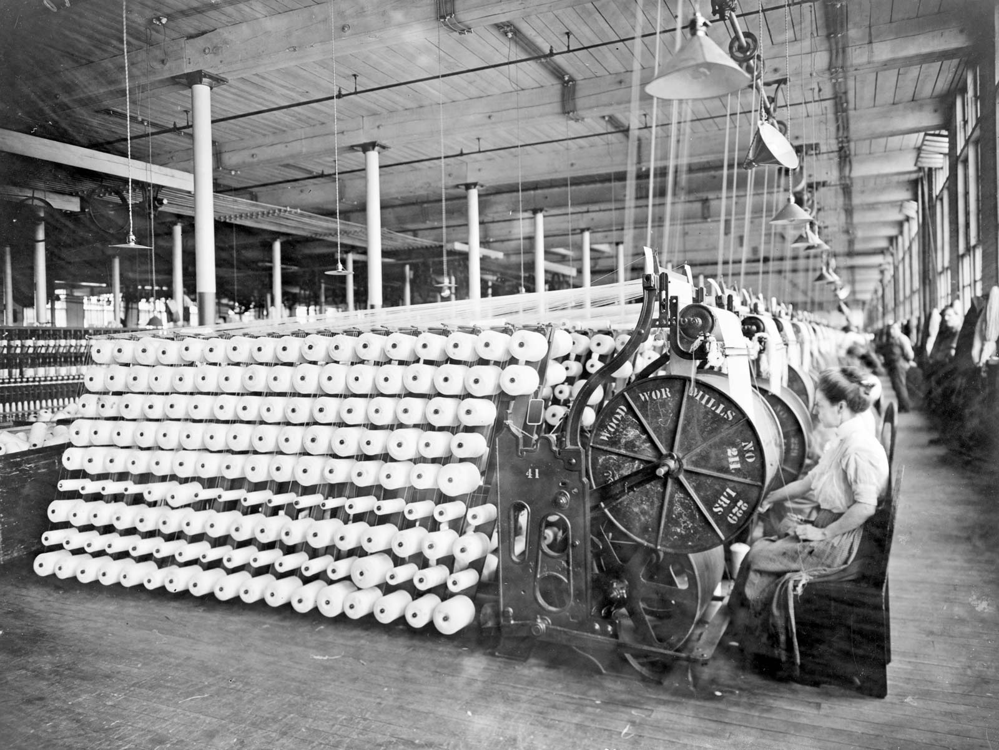
SAMPLE QUESTION 3, 7 Marks
The british army using its vast local resources and superior weapons and skills by taking control of more land. Due to industrial revolution in the Britain they prepared weapons like enfield rifles and cannons with the help of modern weapons they easily defeated others

Slide 16
SAMPLE QUESTION 3, 7 Marks
The battles of Plassey and Buxar gave the Bristish the vast riches of Bengal and favorable trading rights with the local NAWABS. The provided massive new resources, which the British could use to consolidate control. When they got the Control of the rich states and their wealth they hured their own soldiers and defeated others
The British also introduced governor-general into the provinces who administered them on British lines and provided yet more control. They also appointed Governors and later Commander in Chief to manage the areas properly
The british army using its vast local resources and superior weapons and skills by taking control of more land. Due to industrial revolution in the Britain they prepared weapons like enfield rifles and cannons with the help of modern weapons they easily defeated others

Slide 17
CLASSES WITH AWAIS
LIKE SHARE AND SUBSCRIBE
THANKS FOR WATCHING

